Slide 1
DB Intro W26
Instructor: Kazi Amit Hasan

Slide 2
Important dates
Mid term quiz: Feb 23, 2026 (in class)
Topics: Whatever we cover before reading week.
Instructor office hour: Wednesday 11.30 AM to 12.30 PM (Location will be posted in OnQ)
TA office hour: Every Wednesday 6.30PM to 8 PM (Location will be posted in OnQ)

Slide 3
Assignment deadlines (Tentative)
Assignment | Deadline
Software Setup | Jan 17
Project 1 (ER diagram) | Jan 25
Project 2 (Relational Model Implementation) | Feb 7
Project 3 (Web application) | April 5
Dates are tentative. Date may change depending on what we cover in the class

Slide 4
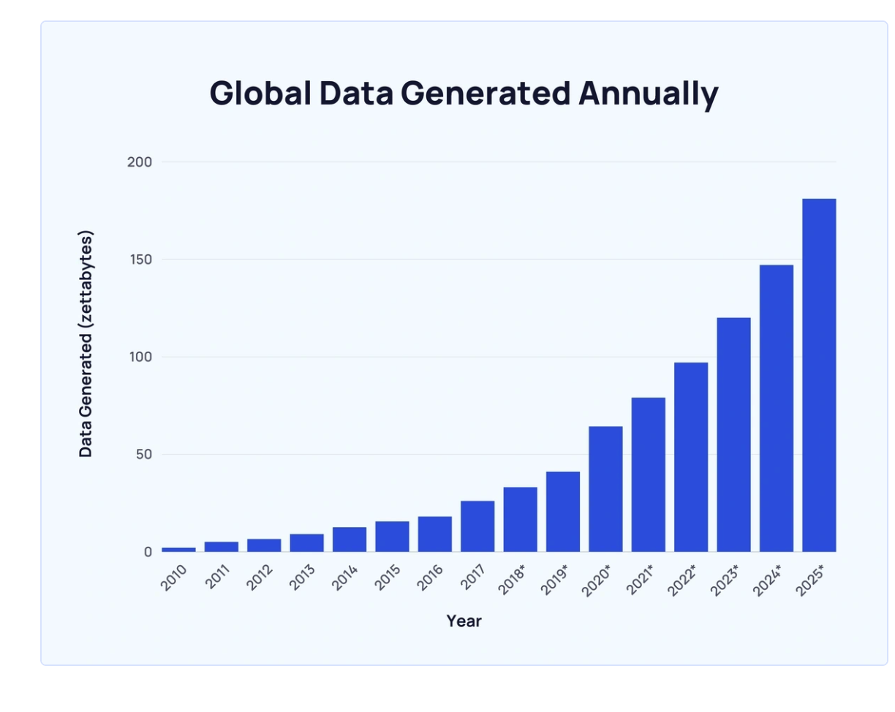
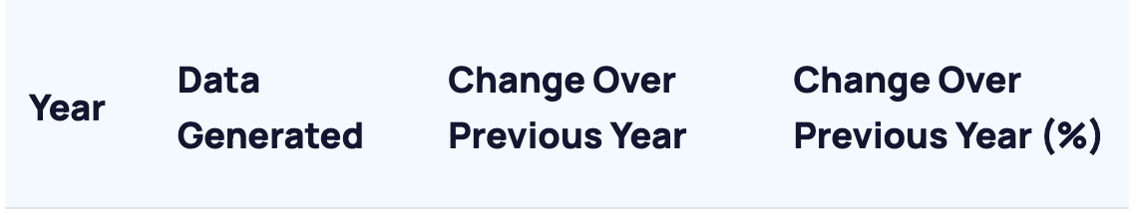
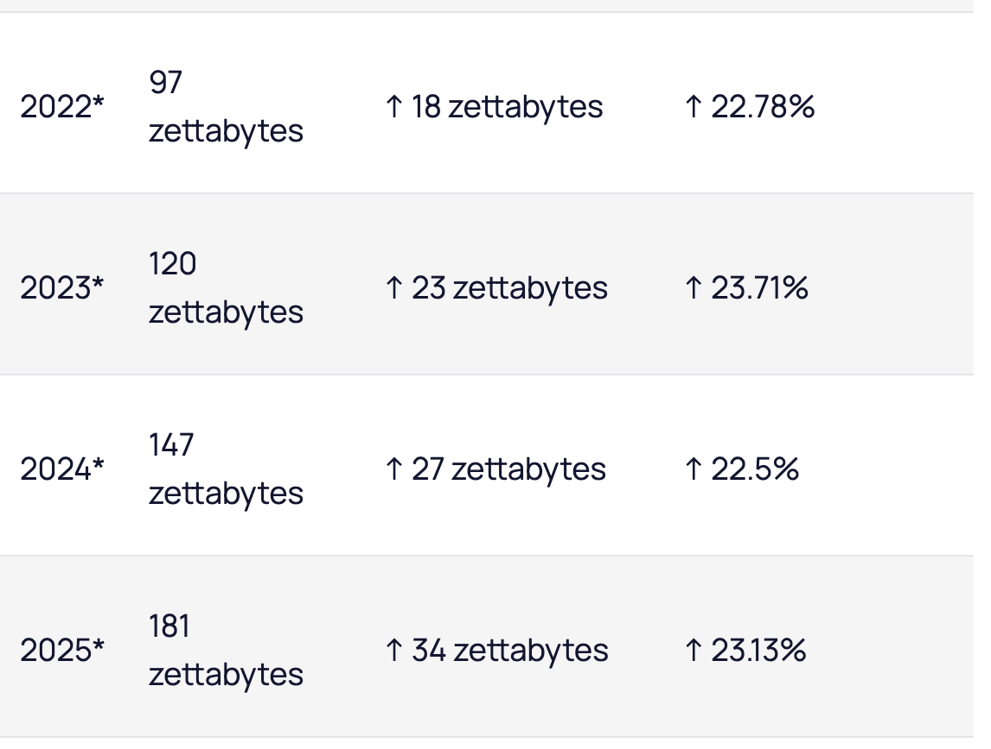
Data are being generated every minute
Source: https://explodingtopics.com/blog/data-generated-per-day

Slide 5
What is data?
What is database?
Collection of raw facts and figures
Must have meanings
Unprocessed and unorganized
Ex: 101, Bus, Bird
Organized collection of related data
Structured and meaningful
Managed using Database Management System (DBMS)
Ex: Student database (ID, Name, Age, Grade)

Slide 6
Examples of where databases are used?
Enterprise information:
Sales: For customers, product and purchase information
HR department: For information about employees, salaries, payroll taxes
Banking and finance: For purchases on credit cards and generation of monthly statements.
Universities: For student information, course registrations, and grades
Any other example?

Slide 7
Types of data in Database
Feature | Structured | Semi-structured | Unstructured
Definition | Organized. Rows and columns | Partially organized. Tags or markers | No predefined format, Raw data
Schema
Storage format
Scalability
Examples

Slide 8
Types of data in Database
Feature | Structured | Semi-structured | Unstructured
Definition | Organized. Rows and columns | Partially organized. Tags or markers | No predefined format, Raw data
Schema | Strict, predefined (e.g tables) | Flexible schema but still has metadata | No schema, highly flexible
Storage format
Scalability
Examples

Slide 9
Types of data in Database
Feature | Structured | Semi-structured | Unstructured
Definition | Organized. Rows and columns | Partially organized. Tags or markers | No predefined format, Raw data
Schema | Strict, predefined (e.g tables) | Flexible schema but still has metadata | No schema, highly flexible
Storage format | Relational database (SQL) | JSON, XML, YAML, NoSQL database | Text files, images, NoSQL database
Scalability
Examples

Slide 10
Types of data in Database
Feature | Structured | Semi-structured | Unstructured
Definition | Organized. Rows and columns | Partially organized. Tags or markers | No predefined format, Raw data
Schema | Strict, predefined (e.g tables) | Flexible schema but still has metadata | No schema, highly flexible
Storage format | Relational database (SQL) | JSON, XML, YAML, NoSQL database | Text files, images, NoSQL database
Scalability | Vertical scaling (bigger server) | Horizontal scaling (distributed systems) | Requires special storage and indexing
Examples

Slide 11
Types of data in Database
Feature | Structured | Semi-structured | Unstructured
Definition | Organized. Rows and columns | Partially organized. Tags or markers | No predefined format, Raw data
Schema | Strict, predefined (e.g tables) | Flexible schema but still has metadata | No schema, highly flexible
Storage format | Relational database (SQL) | JSON, XML, YAML, NoSQL database | Text files, images, NoSQL database
Scalability | Vertical scaling (bigger server) | Horizontal scaling (distributed systems) | Requires special storage and indexing
Examples | Customer database | HTML, JSON | Social media posts, images
If I want to:
Update
Add
Delete
Create
Need a system
DBMS

Slide 12
Types of data in Database
Feature | Structured | Semi-structured | Unstructured
Definition | Organized. Rows and columns | Partially organized. Tags or markers | No predefined format, Raw data
Schema | Strict, predefined (e.g tables) | Flexible schema but still has metadata | No schema, highly flexible
Storage format | Relational database (SQL) | JSON, XML, YAML, NoSQL database | Text files, images, NoSQL database
Scalability | Vertical scaling (bigger server) | Horizontal scaling (distributed systems) | Requires special storage and indexing
Examples | Customer database | HTML, JSON | Social media posts, images

Slide 13
Why Study Database?
When is the last time you hit a database?
Data is a key resource of most organization.
DBMSs are a key component in most applications:
banking, making reservations, purchasing, borrowing a book, checking your marks/schedule
browsing an online catalog, video-on-demand, interactive maps & images, data warehouses, social networks, search engines
online shopping

Slide 14
Why Study Database?
DB systems involve fundamental concepts in computer science ◦ Abstraction – data models, languages (SQL, relational algebra) ◦ Concurrency – locking, concurrency control protocols ◦ Security ◦ Optimization ◦ Performance management
JOBS

Slide 15
Relational DBs
Relational DBMS are one of the most prevalent, successful and enduring software systems
IBM DB2: 1974
IBM built a prototype called System-R. This is historically significant because it was the project that created SQL (Structured Query Language)
invented the Relational Database, but they didn't immediately sell it.
Oracle: 1977
releasing a commercial product first
became the dominant database for huge corporations and banks.
Expensive and powerful

Slide 16
Relational DBs
MySQL: 1995
Two versions: Open source and enterprise
Declared DBMS of the year 2019
Microsoft SQLServer: 1989
If a company uses Windows Servers and .NET code, they almost always use SQL Server. It is known for having great user interface tools
PostgreSQL: 1988
Open sourced
Considered as feature rich and strict than MySQL

Slide 17
Non Relational DBs
Other type of databases include:
MongoDB, CouchDB:
Store data as documents (json)
Redis, DynamoDB:
Key/value pairs
Cassandra, Hbase:
store data by columns (useful for data analytics applications)
Neo4j, Amazon Neptune
graph databases – useful for social networks, recommendation systems etc.

Slide 18
CISC/CMPE 332
This course focuses on the basics of Relational Systems
Why are we stuck in the “dark ages”?
Because these systems are still in mainstream use and the major DBMSs are

Slide 19
Concepts and Terminology
Data Model: the rules/language we use to describe data using:
Uses a collections of tools (diagram/specialized vocabulary)
Types of data model:
Relational Model
Entity Relationship (ER) Model
Hierarchical Model
Object Based Data Model
Network data model etc

Slide 20
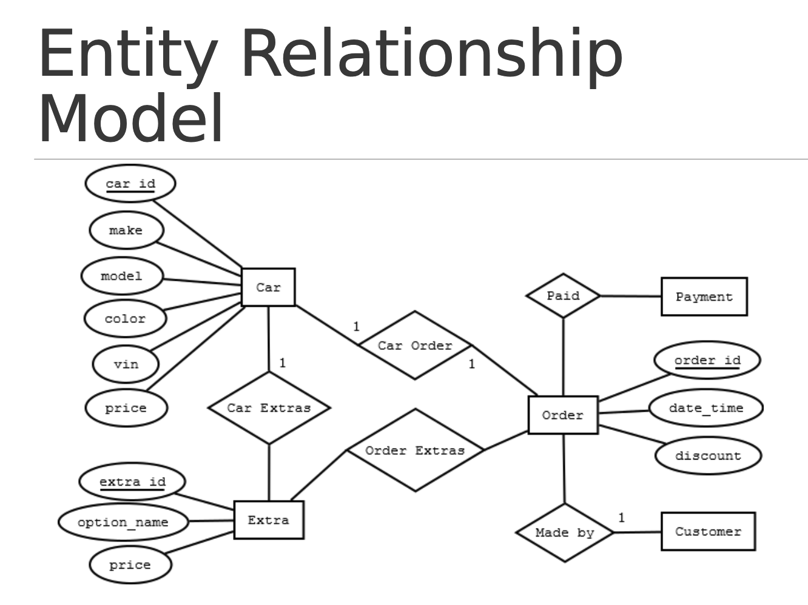
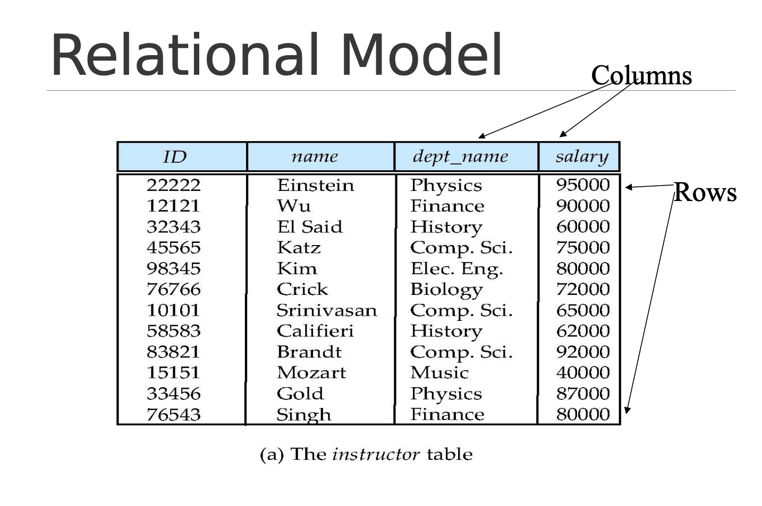
Concepts and Terminology

Slide 21
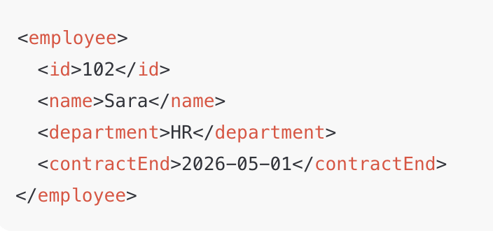
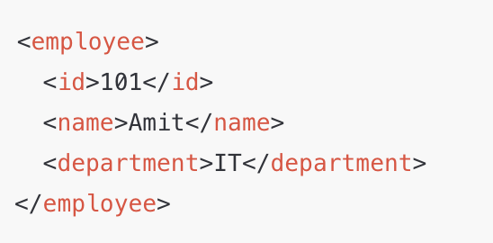
Concepts and Terminology
Semi structured data models:
- Permits the specification of data where individual data items of the same type have different sets of attributes.
Both are employee
Second one has an extra field
Still valid

Slide 22

Concepts and Terminology
Schema: the actual description of database using data model
It describes:
What data is stored
How it structured
Relationships and constraints
Schema works as the final blueprint of database created using data model
Example of relational schema

Slide 23
Concepts and Terminology
Database management system (DBMS)
Set of programs that enable users to perform certain operations in DB
MySQL, DB2, Oracle

Slide 24
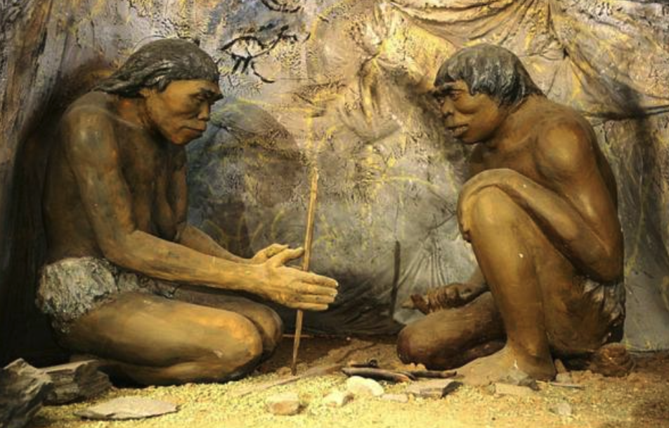
Life Before DBMSs
Before “integrated databases” (a system managing data accessible by concurrent users):
applications and data were tightly coupled.
flat files used for data storage
often storage of data was repeated
data files were created specifically for that department.
“data silos” – inaccessible to other departments within the same organization
Notes:
Data silos are isolated data collections within an organization, controlled by one department or system, making them inaccessible to others,

Slide 25
Advantages of Integrated DBMS
1. Sharing of data 2. Reduced redundancy – data stored only once (reduces errors) 3. Data Consistency – any update only needs to be done once 4. Better Security – all access through the DBMS – easy to track 5. Improved Integrity – rules/constraints that the data must follow can be enforced by the DBMS (e.g. prereq courses) 6. Faster application development & decoupling of data/applications 7. Concurrency control -- multiple accesses at the same time without interference 8. Backup and recovery built into the DBMS

Slide 26
Human Roles in DBMSs
End Users:
sophisticated users who know how to query the data using a query language
data scientists – using AI tools to identify patterns, relationships or trends
naïve users – using applications to select specific things to do (restricted access
Application Programmers:
programmers that build database access into their applications
Database Administrator:
responsible for designing (maybe), securing and maintaining the database.
superuser – controls who can access what data
backup/restores
security

Slide 27
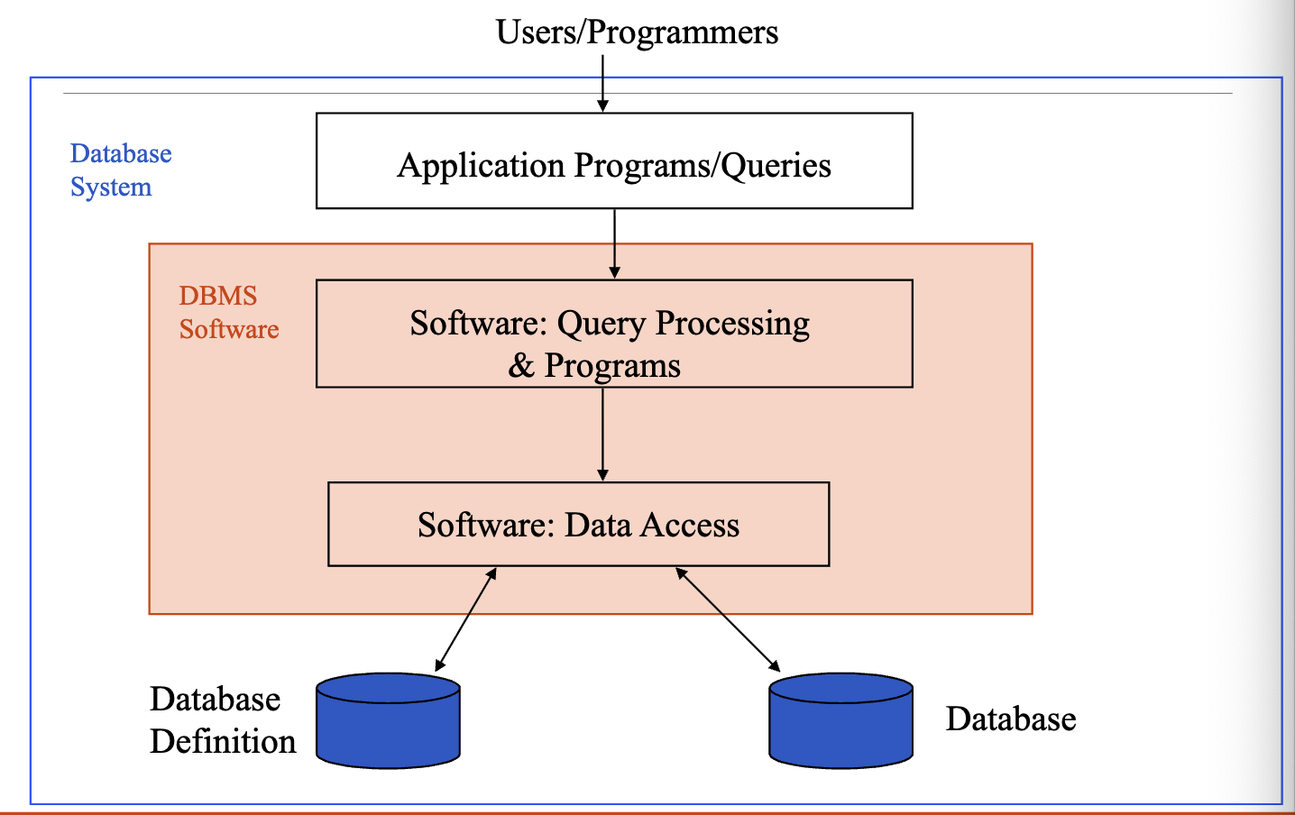
Database System Environment
Users/Programmers do not touch the DB directly.
Represents web applications, desktop software’s, SQL queries
Process query, checks permissions, optimize queries etx
Reads and writes data on disk
Contains schema, definition, constraints
Contains actual data

Slide 28
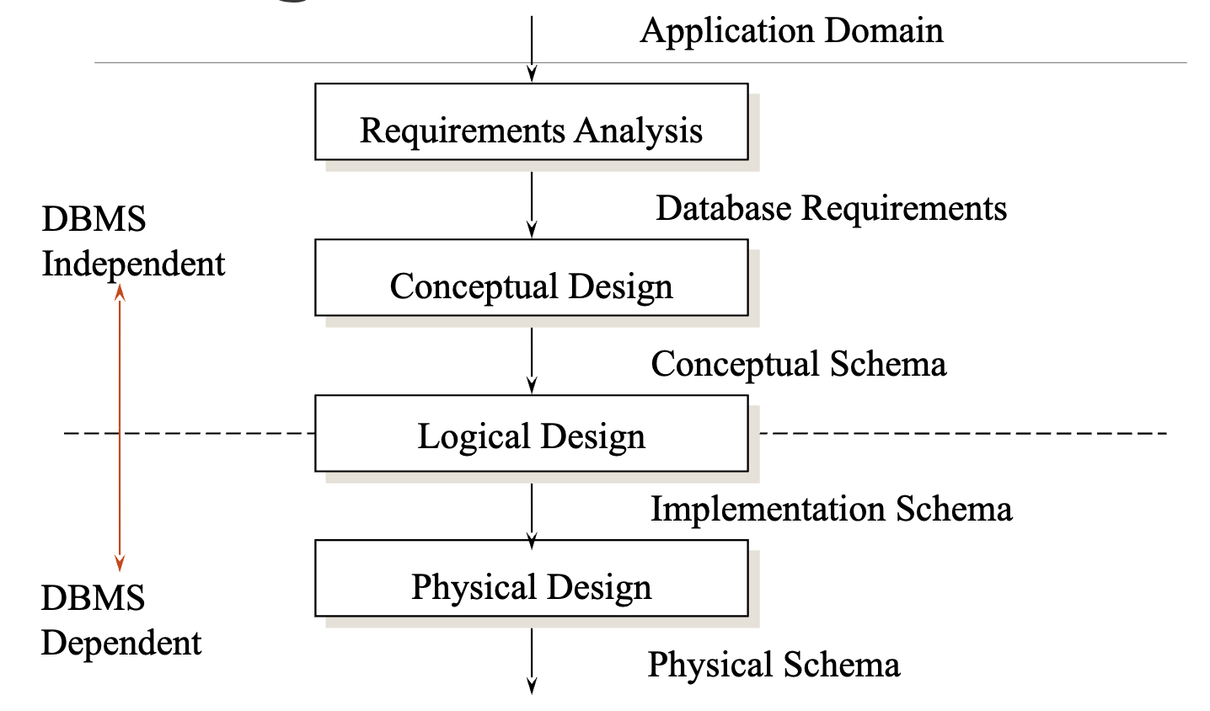
Phases of Database Design
Requirment Analysis:
Understand and document what the database needs to store and how users will use it.
Collect requirements, define business rules etc
Conceptual Design:
Create high-level data model independent of any specific DBMS.
Get an ER diagram as conceptual schema

Slide 29
Phases of Database Design
4. Logical Design
convert the ER diagram into a logical schema, usually relational tables.
Using primary keys, foreign keys etc
Output is an implementation schema
5. Physical Design
Specify how the logical design will be physically implemented in a particular DBMS.
Use MySQL, choose data types, storage optimization

Slide 30
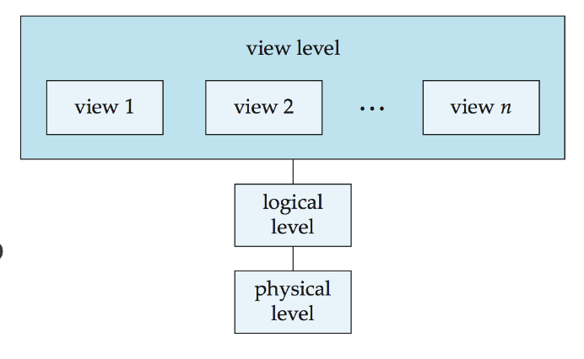
3 Schema DB Architecture
External Schema (View Level):
Highest level of abstraction, closest to end users
Hides rest of the database from users and only presents relevant data
Ensures security and usability
Conceptual Schema (Logical Level)
Describes the logical structure of the entire database
Defines what data is stored, relationships among data
DB Designers work at this level using data models
Internal Schema (Physical Level):
Lowest level of abstraction
Deals with actual physical storage of data.
DBA have access
DB designers, users are unaware of these physical storage specifics

Slide 31
Example
View level
Student view
Instructor view
Deans view
ER model/Relational model
Student table, course table, faculty table, deans table >> their relationship/blueprint
Logical level
Physical level
Physical
HDD/SDD/distributed/centralized
Do users know where data are being stored?

Slide 32
3 Schema DB Architecture
Advantages:
Security
Flexibility
Physical data independence:
ability to change the physical level without requiring changes to the logical level.
Ex: change storage device
Logical data independence:
Adding/removing attributes
Makes system more flexible and easier to maintain

Slide 33
Data Independence
View Level
Logical data independence
Logical level
- Adding column in table
Physical data independence
Physical level
Storage structure,
Data structure change
Index change
You are using HDD to store data? If I want to switch to SSD - Do I need to redesign the whole DB?
- How will it affect the system

Slide 34
Book reference:
Database system concepts (6th Edition) >> 1st chapter
Recommended:
Look at exercises 1.7 to 1.15
Next: ER diagrams

